Slide 1
Cloud Computing

Slide 2
Background
2010 WGITA approved the cloud computing project with SAI USA as lead and Canada & India as members
2011 A status report was presented and comments solicited
2012 Final project description and common cloud computing risks were presented
Members requested that this work be augmented with a cloud computing guide and audit handbook
Guide & handbook completed for CC.
2013 Will be incorporated into the overall IT Audit Guide & Handbook in cooperation with IDI

Slide 3
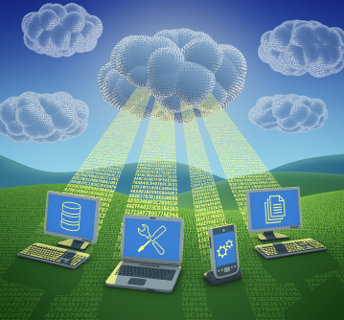
What Is Cloud Computing?
Generally speaking, cloud computing can be thought of as anything that involves delivering hosted services over the Internet.
According to NIST Cloud computing is a model for enabling ubiquitous, convenient, on-demand network access to a shared pool of configurable computing resources (e.g., networks, servers, storage, applications, and services) that can be rapidly provisioned and released with minimal management effort or service provider interaction. (Special Publication 800-145)

Slide 4
What It Provides
Cloud computing provides shared services as opposed to local servers or storage resources
Enables access to information from most web-enabled hardware
Allows for cost savings – reduced facility, hardware/software investments, support

Slide 5
Essential Characteristics
On-demand self-service
  A consumer can unilaterally provision computing capabilities, such as server time and network storage, as needed automatically without requiring human interaction with each service provider.
Broad network access
  Capabilities are available over the network and accessed through standard mechanisms that promote use by heterogeneous thin or thick client platforms (e.g., mobile phones, tablets, laptops, and workstations).
  Source: NIST Special Publication 800-145

